Slide 1
What Gives You Authority?
Voice in Creative Nonfiction

Slide 2
Developing and “Practicing” Your Voice
Letter Writing
Journaling
Blogging

Slide 3
The Importance of Writing Letters
It’s a place where your personality can naturally shine through.
Your recipient is a sounding board for your thoughts and observations. This may eventually become a piece of writing.
The recipient may note something in your writing that you never knew about yourself.

Slide 4
Read Letter Collections!

Slide 5
The Importance of Journaling
How can you tell a story to someone if you haven’t first told it to yourself?
Capturing in the moment emotions and details that will soften or even disappear for you over time.

Slide 6
Writing This Child of Faith

Slide 8
Read Other People’s Journals!

Slide 9
The Importance of Blogging
You’re writing regularly, often informally.
That informality can free up your voice.
You start to notice, over time, the things you tend to talk about a lot—you discover your passion.
You can then hone in on that passion and focus on it in other writing.

Slide 10
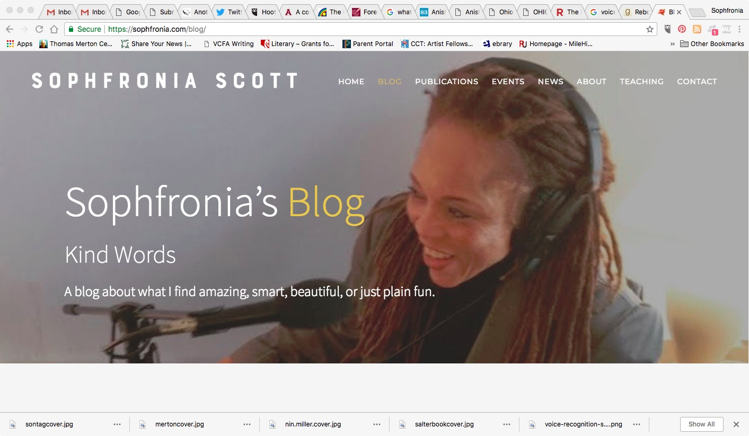

Slide 11
A Side Note: Changing Your Voice

Slide 12
Exercise
What they don’t tell you about…

