Slide 1
The art of memoir
Narrative applied to real life
By Sophfronia Scott

Slide 2
What are your most pressing questions about writing memoir?

Slide 3
What’s the difference?
Notes:
--Often writers get overwhelmed because they are thinking in terms of autobiography, how to fit in everything, when really they can be more focused on a certain incident or memory.
--But both seek to apply narrative to real life, and that’s what we’re focusing on today—making life into art.

Slide 4
How to begin
Notes:
Donal Logue: Gotham, Viking, Sons of Anarchy, more television shows, countless film.
--Look at his piece and note the basics of storytelling.

Slide 5
Where it would be nice to end up
Notes:
--This could have been a lurid “tell all” type of book but it’s not. It represents the grace present in both personalities.
--examine the writing, how she has turned her life into art
--How do we make this journey toward turning life into art?
Artistry is misunderstood. People think if you pile on pretty words, that’s enough, that’s artistry.
--We’re going to talk about pretty words, yes, but the words have a purpose if you use them properly, if you use them with intention.

Slide 6
If you’re not careful…
Notes:
Artistry is a magic wand, and you must wield it with intention. The best witches and wizards are powerful in their hearts as well as their minds and they can focus that power when the time comes to conjure a spell.
But if you don’t learn well here’s what can happen. Goyle conjures fiendfyre but he can’t control it and it destroys him.

Slide 7
Scenemaking
Put your reader in the room.
Scene takes place in a specific place, at a particular time
Exposition doesn’t need place or a time frame—put it before or after a scene, not in the middle!
Notes:
Quote Bill Roorbach: “It’s the painful truth of memoir making: you can’t tell it all…Scene is vital. And scene is nearly always what’s missing when a piece of creative nonfiction fails to come to life.”
--Discuss example of the student wanting to explain family dynamics when all she had to do was describe what was on the dinner table and how they were all seated.
--writers lean too much on exposition, or do too much summary, too little scene.

Slide 8
Scenes have…
Characters
Dialogue
Action
Description

Slide 9
The Highlighting Exercise

Slide 10
Using Detail and description
The writer uses vivid detail to invite the reader in to share the experience on the page.
Notes:
--Description can do so much more than tell us what something looked like. It can tell us where a person is in their day, what their past experience has been, where they’re from, their social class.

Slide 12
Exercise: listening
--What details do you hear?
--What are you learning from the detail beyond “this is what he/she/it looks like.”

Slide 13
Metaphor
A figure of speech in which a word or phrase is applied to an object or action to which it is not literally applicable.
A thing regarded as representative or symbolic of something else, especially something abstract.

Slide 14
Metaphor
Metaphor helps us to understand what this experience in the past actually meant.
-Sue William Silverman

Slide 15
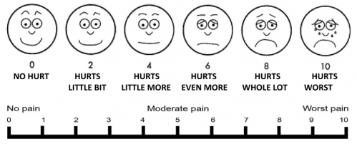

Slide 17
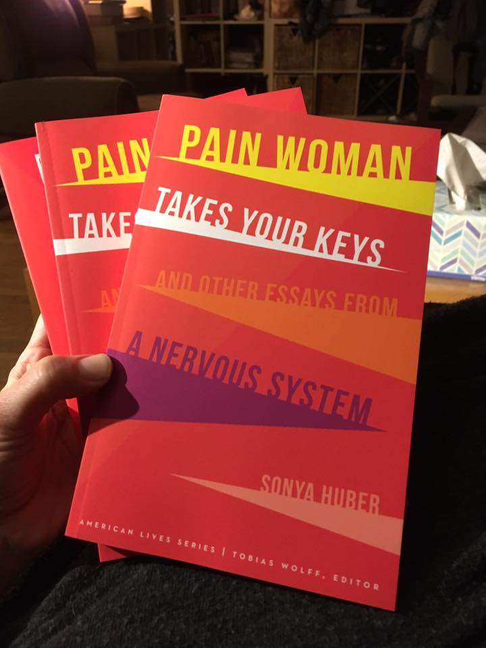

Slide 18
Metaphor
“Once you have developed metaphor, you’ve transformed your life into art and all art is universal.”
–Sue William Silverman

Slide 19
exercise
A Mind Like a Steel Trap

Slide 20
Break

Slide 21
Narrative arc
What’s the best way to tell your story?
Beginning to end
Switch between past and present
Tell the story, then spend rest of book examining the effects
Notes:
--Beginning to end (The Bright Hour)
--Switch between past and present (Come to the Edge)
--Tell the story, then examine the effects (Wave)
--I’m offering these as suggestions and it won’t be apparent right away the best way to tell your story. I encourage you to experiment.

Slide 22
Introducing Tension through structure
Withholding Information
Manipulating Time
Juxtaposition
Well-placed Questions

Slide 24
Tools for discovery
Journaling
Interviews
Digging for clues (check weather reports, news reports, calendars, etc.)
Notes:
How to you get the material to work with? You might think, “Well, I know my story, it’s my story!” But do you have access to the details that will take it beyond basic storytelling? Can you flesh it out, put the reader in the scene, understand what you were feeling at the time? This is how you work with memory.
--Digging for clues: What else was going on in the world on these dates? What was I responding to? Where was I emotionally? This can remind you of behaviors you normally do in X weather.

Slide 25
The importance of journaling
How can you tell a story to someone if you haven’t first told it to yourself?
Capturing in the moment emotions and details that will soften or even disappear for you over time.

Slide 26
Developing and “Practicing” your voice
--Letter writing
--Journaling (what does a journaling practice look like?)
**When journaling you are figuring out what/how you think
**You are also practicing what we’re learning today
Notes:
Question: First, what do you think you sound like? Next, how do you want to sound?

Slide 27
exercise
What they don’t tell you about…

Slide 28
Resources
Sophfronia.com
Menu item: “Teaching”
Notes:
Under “Resources” tab. This PowerPoint, also book lists, helpful links.

Slide 29
May your strength give us strength
May your faith give us faith
May your hope give us hope
May your love bring us love
“Into the Fire” by Bruce Springsteen

